Slide 1

Python Programming: Conversion in Functions
Python Programming | Built in function and user define function
Course: Python Programming | Chapter: Built in function and user define function | Bachelor of Engineering
DISCOVER · LEARN · EMPOWER
Notes:
Welcome everyone to today's session on Python Programming. We are focusing specifically on the topic of Conversion within the context of built-in and user-defined functions. This session is designed for our Bachelor of Engineering students to master data type manipulation. Remember, our motto is Discover. Learn. Empower, and today we will empower you with conversion techniques.

Slide 2
Course Outcomes
SLIDE 2 / 14
Course Outcome
CO | BT LEVEL | DESCRIPTION
CO1 | BT1 | Understand the syntax, control structures, and basic constructs of Python programming language
CO2 | BT3 | Apply functions, modules, and exception handling for modular program development
CO3 | BT3 | Implement data structures including lists, tuples, dictionaries, and sets for efficient data processing
CO4 | BT4 | Analyze and manipulate files, strings, and perform data handling operations
CO5 | BT5 | Design and develop real-world applications integrating multiple Python concepts
Chandigarh University
2 / 14
Notes:
Today's lecture directly addresses two specific Course Outcomes. First, CO3 requires you to implement data structures efficiently, which relies heavily on correct data type conversions. Second, CO4 focuses on analyzing and manipulating strings and files, where conversion is a fundamental prerequisite for data handling. Mastering these outcomes ensures you can process complex data without errors.

Slide 3
Learning Objectives
SLIDE 3 / 14
Learning Outcomes
1
Analyze the necessity of type conversion in mixed-type arithmetic operations
2
Evaluate the differences between implicit and explicit conversion mechanisms
3
Apply built-in conversion functions like int(), float(), and str() correctly
4
Design user-defined functions to handle custom data type transformations
5
Identify common runtime errors caused by improper conversion attempts
Chandigarh University
3 / 14
Notes:
By the end of this lecture, you will be able to analyze why Python requires specific types for operations. You will evaluate the distinct behaviors of implicit versus explicit conversion. We will apply built-in functions to transform data types and design your own functions for custom needs. Finally, you will identify and avoid common errors that occur during these processes.

Slide 4
Lecture
SLIDE 4 / 14
Implicit Type Conversion
EXAMPLE
5 + 2.5 results in 7.5 automatically without user intervention
• Python automatically converts smaller data types to larger ones during operations
• Integer addition with float results in a float without explicit code
• This process prevents data loss during arithmetic calculations between types
• The interpreter handles the conversion silently before the operation executes
• Implicit conversion ensures type safety in mixed arithmetic expressions
• No function call is required for the interpreter to perform this task
Chandigarh University
4 / 14
Notes:
Implicit conversion happens automatically when Python detects a potential loss of precision. For instance, adding an integer 5 to a float 2.5 results in 7.5 without you writing any code. The interpreter promotes the integer to a float to maintain accuracy. This is crucial for preventing data loss in your calculations.

Slide 5
Lecture
SLIDE 5 / 14
Explicit Type Conversion
EXAMPLE
int(3.9) converts the float 3.9 to the integer 3 by truncation
• Explicit conversion requires the programmer to manually specify the target type
• Functions like int(), float(), and str() force a specific data type change
• This method is necessary when implicit conversion is not possible or desired
• Using explicit conversion makes the code intent clear to other developers
• Explicit conversion allows precise control over data representation in memory
• It prevents unexpected type errors in user-defined function arguments
Chandigarh University
5 / 14
Notes:
When automatic conversion isn't enough, you must use explicit conversion. You manually call functions like int() or float() to force a change. For example, converting the float 3.9 to an integer results in 3, effectively truncating the decimal part. This gives you precise control over how data is stored and processed.

Slide 6
Lecture
SLIDE 6 / 14
Conversion Functions Overview
1
int() converts strings or floats to integer values by truncating decimals
2
float() converts integers or strings into floating-point numbers with decimals
3
str() converts any data type into a string representation for display
4
bool() converts values to True or False based on their truthiness
5
list(), tuple(), and set() convert iterables into specific collection types
6
Each function returns a new object of the target type
7
These functions are built-in and available without importing any modules
Chandigarh University
6 / 14
Notes:
Python provides a suite of built-in functions for converting data types. The int() function truncates decimals, while float() adds decimal points. The str() function is essential for displaying data, and bool() determines truthiness. Collection converters like list() and tuple() allow you to reshape data structures efficiently.

Slide 7
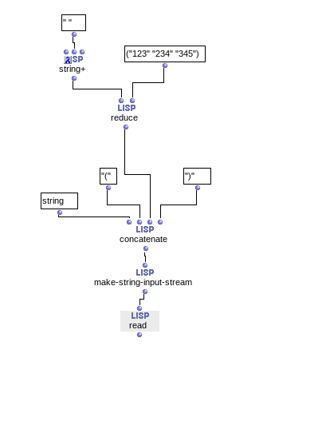
Lecture
SLIDE 7 / 14
String to Number Conversion
EXAMPLE
int('123') successfully returns the integer 123
• Converting a numeric string to int requires the string to contain only digits
• Leading or trailing whitespace is automatically stripped before conversion
• Converting '12.5' to int fails because the string represents a float
• You must convert to float first if the string contains a decimal point
• Invalid characters like letters cause a ValueError exception during conversion
• Always validate string content before attempting numeric conversion in functions
Source: discussion.forum.ircam.fr
Chandigarh University
7 / 14
Notes:
Converting strings to numbers is common but requires care. A string like '123' converts cleanly to the integer 123. However, '12.5' cannot be converted directly to an integer; it must first become a float. If the string contains letters, Python raises a ValueError. Always validate your input strings to ensure they contain valid numeric characters.

Slide 8
Lecture
SLIDE 8 / 14
Number to String Conversion
EXAMPLE
str(42) results in the string '42' ready for concatenation
• Converting numbers to strings is essential for file writing and display
• The str() function converts any number to its textual representation
• Floating point numbers retain their decimal representation in the string
• This conversion allows mixing numbers with text in print statements
• It is required when writing numeric data to text files
• The resulting string can be manipulated using string methods
Chandigarh University
8 / 14
Notes:
When you need to display numbers or write them to files, you must convert them to strings. The str() function handles this seamlessly. For example, the integer 42 becomes the string '42', which can be concatenated with other text. This is vital for formatting output and handling file I/O operations.

Slide 9
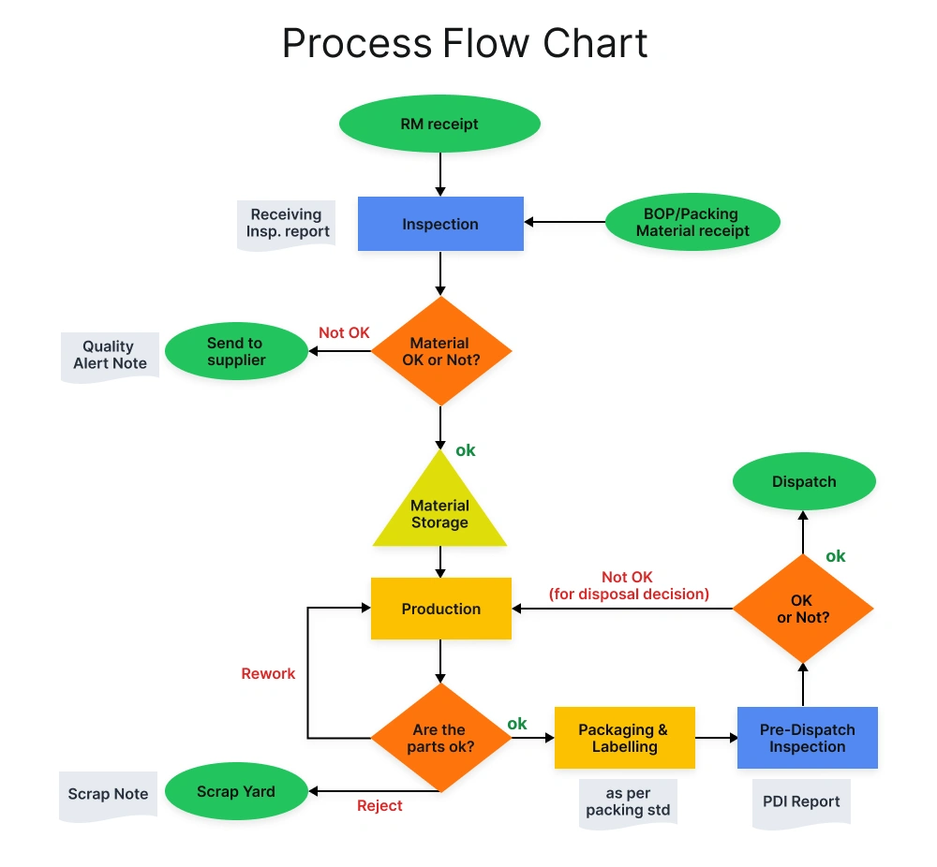
Lecture
SLIDE 9 / 14
Worked Numerical Example
GOVERNING EQUATION
Calculate total price: price = 19.99, quantity = 5, tax_rate = 0.08
CONVERT QUANTITY TO FLOAT
float_qty = float('5') to ensure precision
CALCULATE SUBTOTAL
subtotal = price × float_qty resulting in 99.95
CALCULATE TAX
tax = subtotal × tax_rate resulting in 7.996
CONVERT TAX TO STRING FOR DISPLAY
str_tax = str(round(tax, 2))
FINAL OUTPUT
'Total with tax: 107.95' using string concatenation
• This sequence demonstrates mixed type handling in a real scenario
Source: www.invensislearning.com
Chandigarh University
9 / 14
Notes:
Let's look at a practical calculation. We have a price of 19.99 and a quantity of 5. We convert the quantity to a float to ensure precision in multiplication. The subtotal becomes 99.95, and the tax is 7.996. Finally, we round and convert the tax to a string for display. This shows how conversion functions manage mixed types in real-world logic.

Slide 10
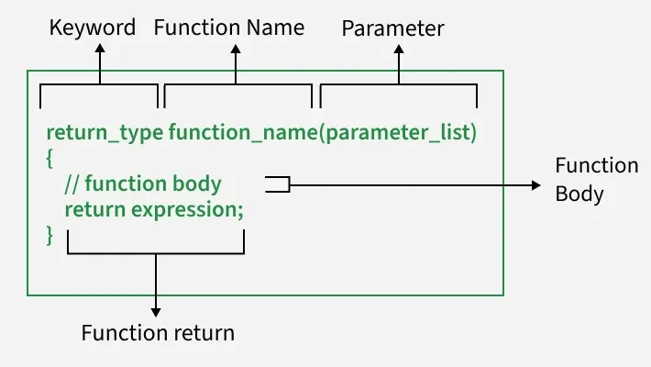
Lecture
SLIDE 10 / 14
User-Defined Conversion Functions
EXAMPLE
def parse_price(s): return float(s.replace('$', ''))
• You can create custom functions to handle specific conversion logic
• Define a function that accepts a string and returns a formatted number
• This allows handling currency symbols before numeric conversion
• User-defined functions encapsulate complex conversion rules for reuse
• They improve code readability by abstracting conversion details
• These functions can include error handling for invalid inputs
Source: media.geeksforgeeks.org
Chandigarh University
10 / 14
Notes:
Beyond built-in functions, you can write your own conversion logic. For instance, a function to parse currency strings removes the dollar sign before converting to a float. This encapsulates complex rules and makes your code reusable. By defining these functions, you abstract the details and improve the readability of your programs.

Slide 11
Lecture
SLIDE 11 / 14
Common Pitfalls and Errors
CASE SENSITIVITY IN BOOLEAN CONVERSION
'True' works but 'true' fails
• Attempting to convert non-numeric strings to numbers raises ValueError
• Converting a float to int truncates the decimal part without rounding
• Implicit conversion fails when types are incompatible like list and int
• Empty strings cannot be converted to numbers and cause exceptions
• Always use try-except blocks to handle potential conversion failures
• Understanding data loss during truncation is critical for financial apps
Chandigarh University
11 / 14
Notes:
There are several pitfalls to avoid when converting types. Converting a float to an integer truncates the decimal, which can be dangerous in financial calculations. Non-numeric strings cause ValueErrors, and empty strings are also invalid. Boolean conversion is case-sensitive, so 'true' will fail. Always use error handling to manage these potential issues gracefully.

Slide 12
Lecture
SLIDE 12 / 14
Conversion in Data Structures
EXAMPLE
set([1, 2, 2, 3]) results in {1, 2, 3} removing duplicates
• Converting lists to tuples creates immutable data structures for safety
• Set conversion removes duplicate elements from a list automatically
• Dictionary conversion requires pairs of keys and values to be valid
• Nested structures require recursive conversion logic for full transformation
• These conversions optimize memory usage and data integrity in processing
• Understanding these transformations is key to efficient data handling
Chandigarh University
12 / 14
Notes:
Conversion is vital for manipulating data structures. Converting a list to a set removes duplicates, which is useful for data cleaning. Converting to a tuple makes the data immutable, ensuring safety. These transformations optimize memory and ensure data integrity. Mastering these conversions is essential for efficient data processing in your programs.

Slide 13
Lecture
SLIDE 13 / 14
Key Takeaways
1
Implicit conversion handles simple type promotion automatically
2
Explicit conversion using functions like int() and str() is mandatory for control
3
String to number conversion requires valid numeric characters only
4
User-defined functions allow custom logic for complex conversion needs
5
Always handle potential ValueError exceptions during type conversion operations
Chandigarh University
13 / 14
Notes:
To summarize, implicit conversion handles simple cases automatically, but explicit conversion gives you control. Remember that string to number conversion requires valid characters. You can create user-defined functions for complex needs. Finally, always handle potential errors to ensure your program runs smoothly.

Slide 14
Lecture
SLIDE 14 / 14
References
PYTHON
A Practical Learning Approach, 1st Edition — T.S. Murugesh, Shriram K. Vasudevan, Sini Raj Pulari
• Learning Python, 6th Edition — Mark Lutz
• Starting Out with Python, Global Edition, 6th Edition — Tony Gaddis
• Introduction to Python Programming and Data Structures, 3rd Edition — Y. Daniel Liang
Chandigarh University
14 / 14
Notes:
For further reading, please refer to the four textbooks listed on this slide. Mark Lutz's 'Learning Python' offers deep insights into the language. Tony Gaddis provides excellent introductory material. Y. Daniel Liang's book covers data structures well, and the text by Murugesh et al. offers a practical approach. These resources will support your continued learning.

